Slide 1
Where Domain Knowledge Really Makes a Difference
Michelle Cascio
Math Teacher, & Education Specialist

Slide 2
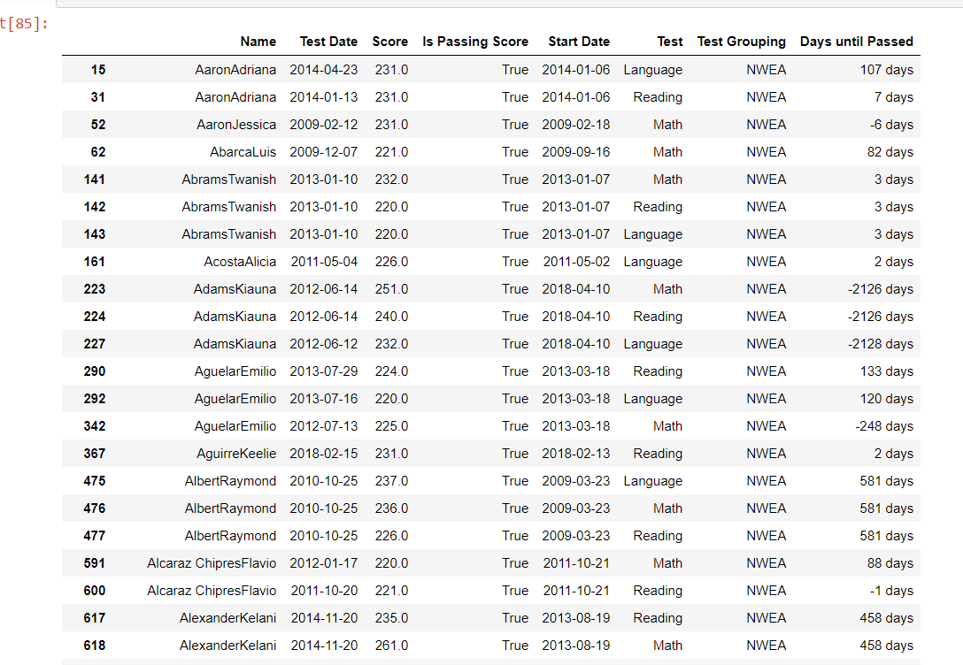
Cleaning the Data : Why would there be negative values for Days until Passed test?
-2126 days?

Slide 3
Cleaning the Data: Mitigate negatives.
Start date was problematic because it represented most recent start date.
Solution?
Use the application date and make comparisons.
That student took almost 6 years to earn pass that test!
-2126 days?

Slide 4
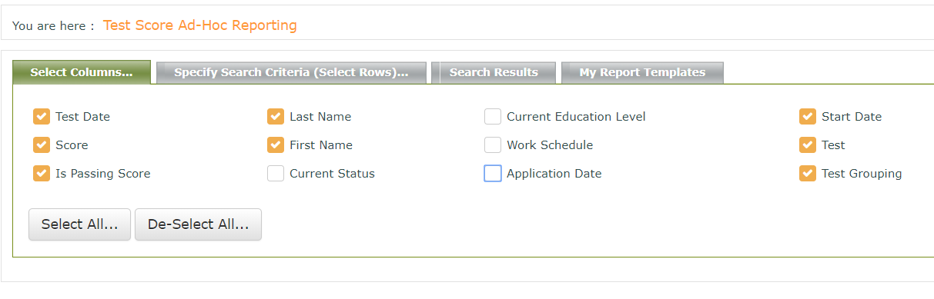
Pull #1
Test Date Start Date

Slide 5

Pull #2
Test Date Application Date

Slide 6
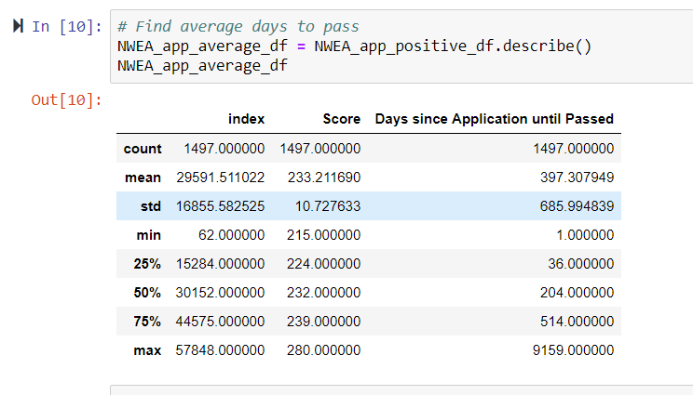
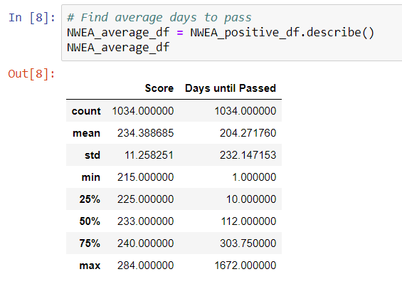
Analyzing the Data: Compare Statistics
On average, it took students 204 days to pass a high school-equivalency test from their most recent enrollment date. In contrast, it took students an average of 397 days to pass a high-school equivalency test from their original application date.

Slide 7
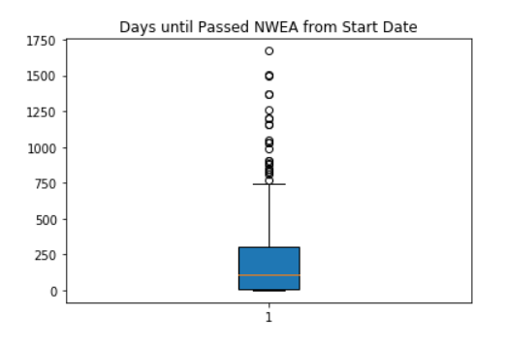
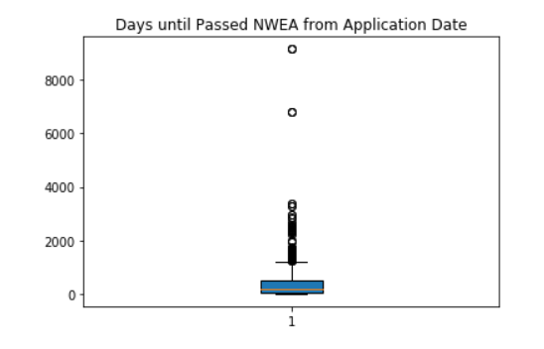
Analyzing the Data: Compare Box and Whisker Plots
Measuring from students’ most recent enrollment date, half of our students pass a test within a range of 10 and 304 days. In contrast, measuring from students’ application date, half of our students pass a test within range of 36 and 514 days.

Slide 8
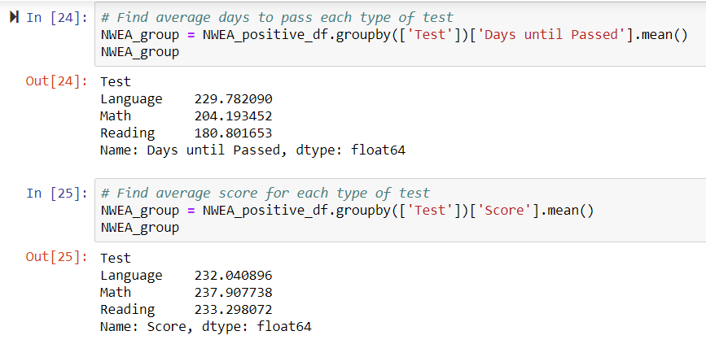
Analyzing the Data: Compare Averages (from enrollment date)
It takes, on average, 49 days and 26 days longer to pass the Language test than the Reading and Math tests, respectively.
Average passing scores on all three tests are between 2-3 points above the passing range.

Slide 9
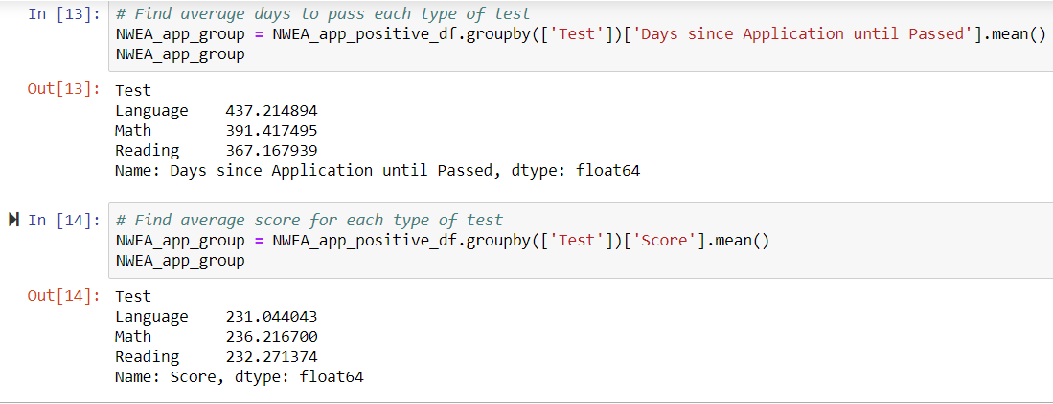
Analyzing the Data: Compare Averages (from application date)
It takes, on average, 70 days and 46 days longer to pass the Language test than the Reading and Math tests, respectively.
Average passing scores on all three tests are between 1-2 points above the passing range.

Slide 10
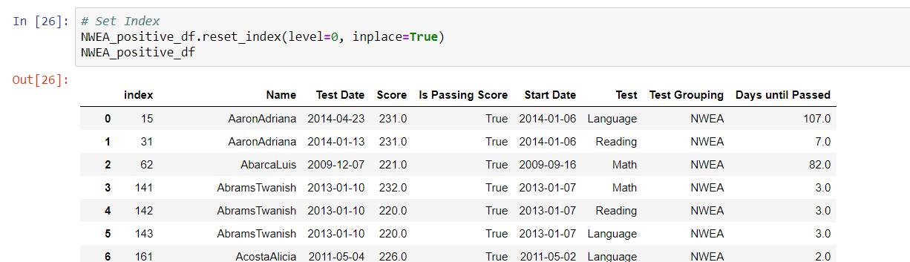
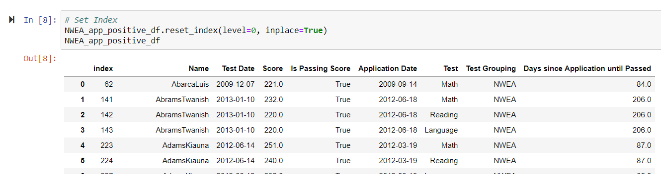
Merging Data into one Database – Step 1
Defining a common index in each data frame before converting to csv and pushing to PostGres allowed a future inner join on a primary key.

Slide 11
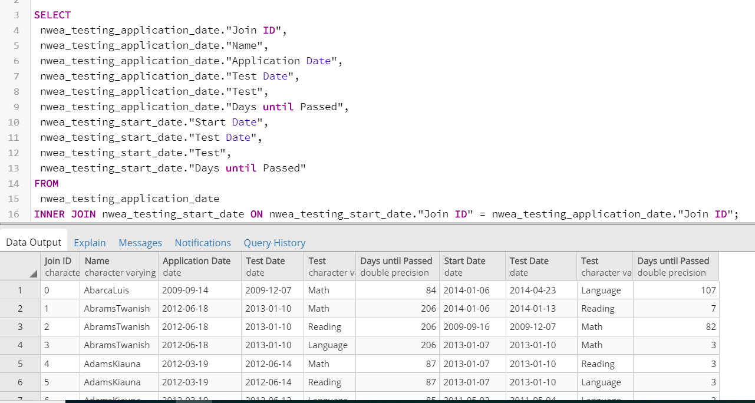
Merging Data into one Database – Step 2
Inner joining the two tables in PostGres allowed me to see the two data points side-by-side in a final production database.
But, initially these two data points were not resting within the same line.

Slide 12
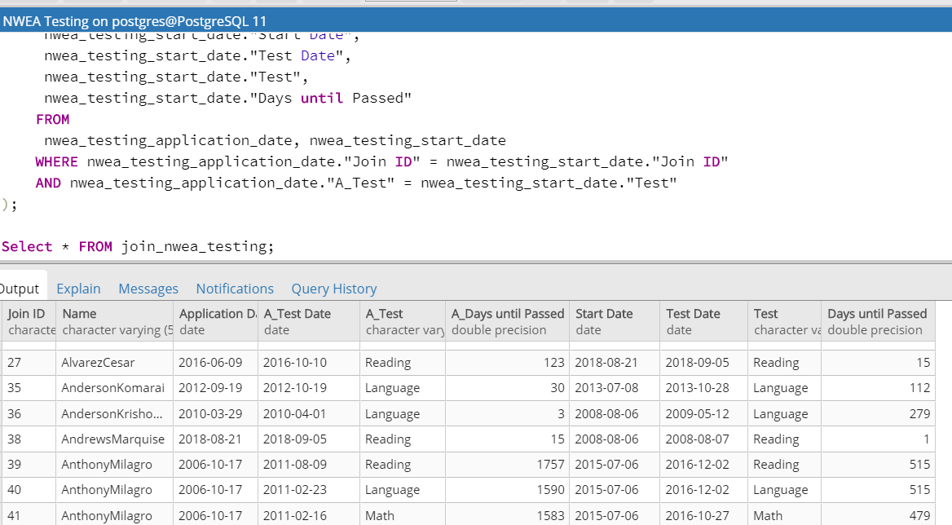
Merging Data into one Database – Step 2 con’t
After further research, I was able to make this Inner Join appear as initially intended.
But, I realized that the new table had only 342 lines because I was looking at students who took and passed the same test on different test dates.
This was interesting because one would imagine if a student already passed this test once, it should not take long for them to pass it a second time. That is not the case looking at the data.

Slide 13
Summary
Students at this school must pass three high-school equivalent subject-matter tests (among other coursework) in order to earn their high school diploma. The three subject matters are Language, Math, Reading. The test is created by the non-profit Northwest Evaluation Association (NWEA).
On average, the Language test takes more number of days to pass than the other two tests (between 26 and 70 days longer). How can class instruction respond to this finding?
Average passing scores for all three tests surpass the passing criteria by less than 3 points. What does this say about the school’s ability to prepare college-ready students?
Although students in the program exit and re-enroll multiple times, the data suggests that students make concrete gains toward a high school diploma within 180-230 days from their last enrollment date. Is this in line with the school’s benchmarks of success?

